Slide 1
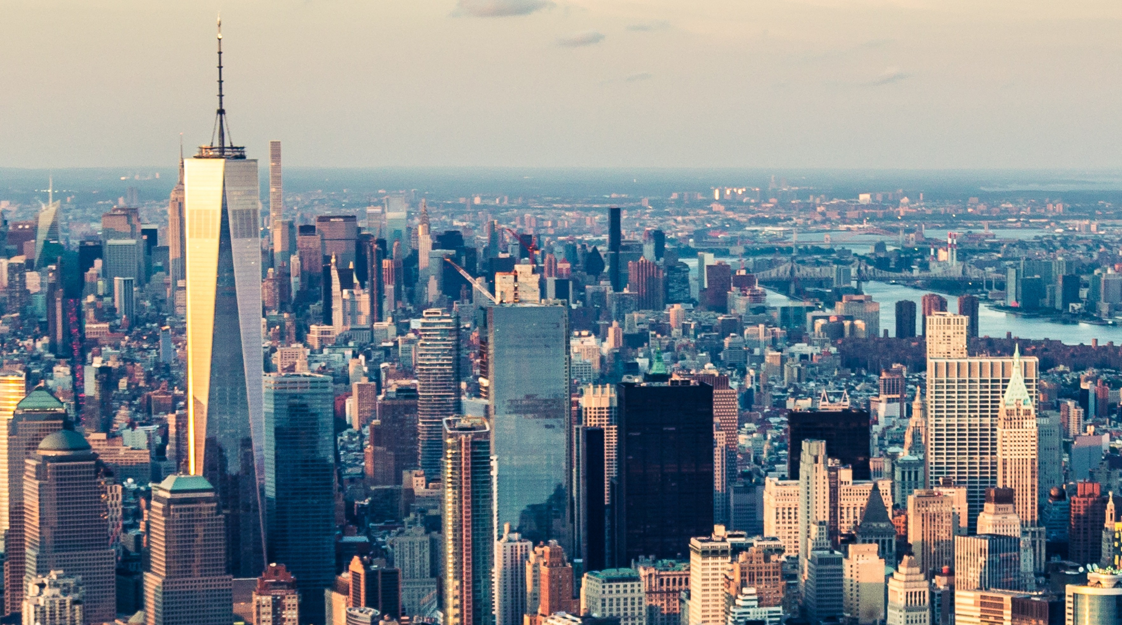
Settlements m3: urban SETTLEMENTS U4: Urban settlement issues
Geography grade 12 © j. rich 2021

Slide 2
The big picture

Slide 3
The big picture (2)

Slide 4
Course overview
Module 1 Nature and types | Module 2 –Rural settlements | Module 3 – Urban settlements
U1: Key concepts: Settlement, site, situation, rural and urban settlements W1 | U1: Role of site and situation, classification, function W2 | U1: Origin, development and classification of urban settlements W5
U2: Classification of settlements W1 | U2: Settlement shapes and land use W2 | U2: Urban hierarchies W5
 | U3: Rural settlement issues W3 | U3: Urban structure and patterns W5
 |  | U4: Urban settlement issues W6

Slide 5
overview
Urbanization trends World
South Africa
2. Issues related to rapid urbanization Lack of planning
Housing shortages
Overcrowding
Traffic congestion
Service provision
3. Growth of informal settlements
4. Case studies of urban management

Slide 6
Urbanization trends
Percentage of population living in cities
What is the difference between level of urbanization and rate of urbanization?
Region | 1995 | 2000 | 2005 | 2010 | 2015 | 2020 | 2025 | 2030 | 2035 | 2040
South Africa | 54,5 | 56,9 | 59,3 | 61,5 | 63,8 | 65,9 | 67,9 | 69,8 | 71,7 | 73,5
Africa | 33,9 | 35,6 | 37,3 | 39,2 | 41,1 | 43,2 | 45,3 | 47,7 | 50,1 | 52,6
Europe | 70,3 | 70,8 | 71,6 | 72.7 | 73,8 | 74,9 | 76,1 | 77,4 | 78,6 | 79,9
World | 44,8 | 46,7 | 49,1 | 51,6 | 53,9 | 56,0 | 58,0 | 59.9 | 61,7 | 63,5

Slide 7
Urbanization trends
Which region has the highest level of urbanization? Why is that likely to be the case?
Which region has the fastest rate of urbanization? What is the probable cause of that?

Slide 8
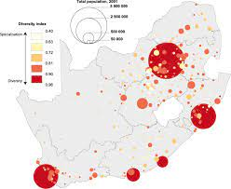
Urbanization in South Africa
Why the level of urbanization so low in Northern Cape? In Limpopo?

Slide 9
Rapid urbanization issues – lack of planning
Uncontrolled flow of people to cities
Provision of housing cannot keep pace
Growth of informal settlements
Lack of proper services

Slide 10
Rapid urbanization issue – housing shortage
End of apartheid = huge upsurge in demand for low cost urban housing
Reconstruction and development plan (RDP)
Conversion of hostels to social housing apartments
Development of new building technologies

Slide 11
Rapid urbanization issue - overcrowding
Increased demand on water and electricity – illegal connections
Blocked sewers and inadequate waste removal – disease risk
Overcrowded schools / overburdened clinics
Increased crime
Greater disaster impact

Slide 12
Rapid urbanization issue – traffic congestion

Slide 13
Traffic congestion
In 2010 in Johannesburg a survey found that:
Almost quarter of its roads experience a 30% reduction in speed daily
342000 commuters had to cancel meetings due to traffic
40% of employees are late for work due to traffic
Daily traffic pressure caused a 64% increase in general stress levels for commuters
Traffic jams cost R1,1 billion per month in lost productivity

Slide 14
Strategies for traffic management
Increase road network / widen roads
Promote public transport
Expand and increase public transport systems
Car pooling
Dedicated lanes
Tolls
Increase parking costs
Reversible lanes
Restricting access according to registration numbers
Limiting the number of cars registered
Non car days
Park and ride schemes

Slide 15
Rapid urbanization issue – service provision
Constitution protects the right to certain services such as water
Informal settlements often badly located for provision of services
High levels of non-payment
Overcrowding leads to breakdowns
Provision has increased and improved greatly in last 20 years
Service delivery protests have also increased

Slide 16
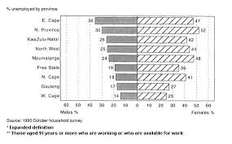
Growth of informal settlements
People move into cities in developing countries faster than the infrastructure can provide for them results in informal housing.

Slide 17
Informal settlements in south africa
Why are there so many more in formal settlements in E. Cape than in W. Cape?
Why are there more women than men in informal settlements?
“Foreign refugees make up many of the inhabitants of informal settlements” Explain if this is true or false according to evidence

Slide 18
Problems associated with informal settlements
Limited access to land ownership
Overcrowding (high population and building density)
Unhygienic living conditions; spread of disease
Illegal and unsafe building structures
Erratic service provision and poor access for emergency services
Limited access to amenities
Environmental destruction, pollution
Social problems e.g. crime, unemployment

Slide 19
Dealing with informal settlements
Previously: relocation and demolition – expensive and slow
Currently: Upgrading on site

