Slide 1
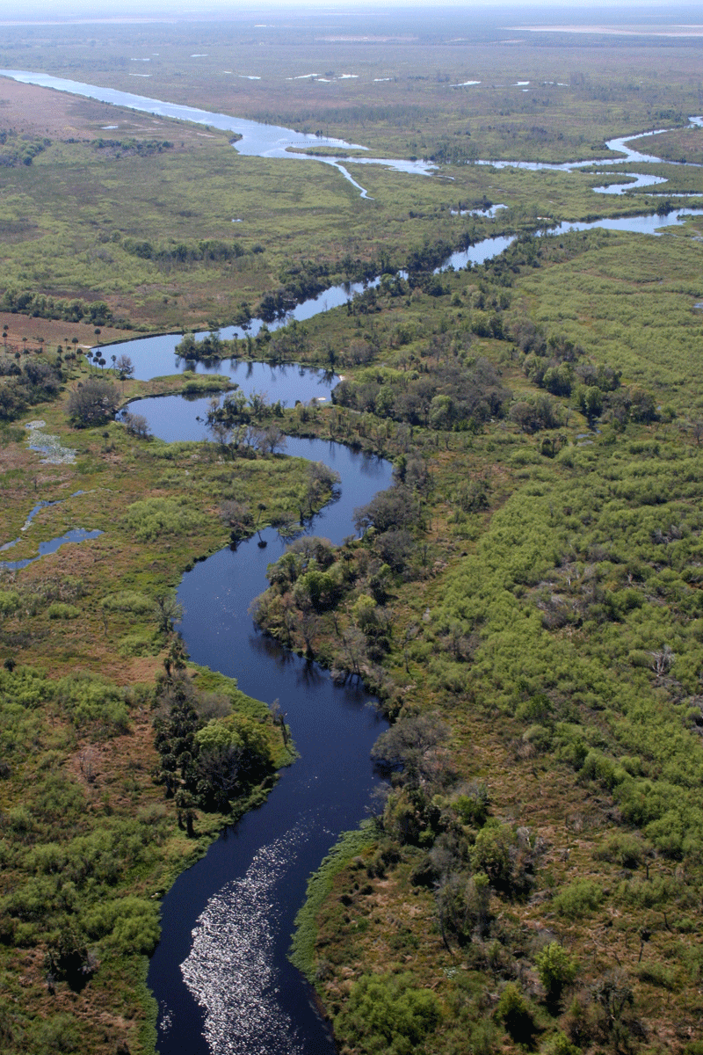
Geomorphology – rivers m2: FLUVIAL PROCESSES U3: RIVER REJUVENATION
Geography grade 12 © j. rich 2021

Slide 2
Course overview
Module 1 Drainage systems | Module 2 –Fluvial processes | Module 3 – Catchment and river management
U1: Importance of studying rivers Defining a stream Key concepts Types of rivers W1 | U1: River profiles Stages of a river River grading W4 | U1: Importance of managing drainage basins and catchment areas W8
U2: Drainage patterns Drainage density W2 | U2: Fluvial landforms W5 | U2: Human impact on drainage basins and catchment areas W8
U3: Stream order and density River discharge Laminar and turbulent flow W3 | U3: River rejuvenation W6 | U3: Case study W9
 | U4: River capture Superimposed and antecedent drainage patterns W7 | U4: Test W9

Slide 3
The big questions In this unit
What happens when a river changes in volume or velocity and what unique landforms does this give rise to?

Slide 4
What is river “rejuvenation”?
OVERGRADED (early) stage of a river – more erosion than deposition
UNDERGRADED (late) stage – more deposition than erosion
But if an overgraded river becomes undergraded it has been REJUVENATED

Slide 5
Why do rivers become rejuvenated?
Rivers become overgraded and gain energy because
INCREASED VOLUME
STEEPER GRADIENT
Climate change and increased rainfall over a long period
Eustatic changes during an ice age cause a drop in sea level
Isostatic uplift

Slide 6
Rejuvenation landforms – Incised meanders
Contours close to the river - a narrow valley with no flood plain
Contours close together – steep valley sides
Many contour lines – valley is very deep

Slide 7
FACTORS THAT AFFECT RIVER IMPACT AND ENERGY
VELOCITY Faster = more erosion; slower = more deposition
VOLUME Greater volume = greater impact
GRADIENT Steeper = more erosion; flatter = more deposition
FRICTION More friction more energy loss

Slide 8
Incised meanders

Slide 9
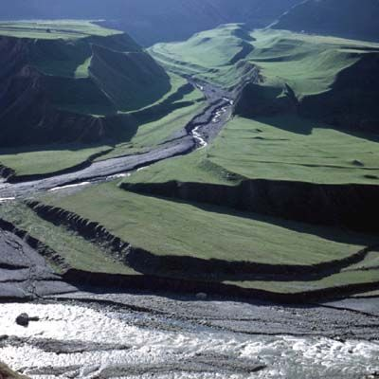
River rejuvenation landforms –River terraces

Slide 10
River rejuvenation landforms - Knickpoints

