Slide 1
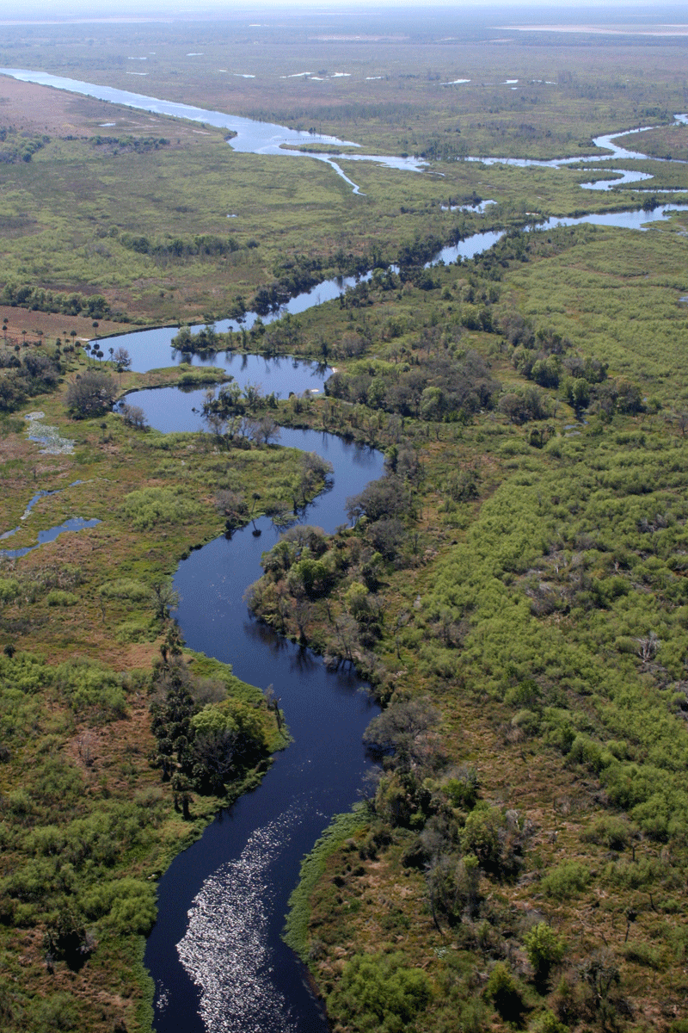
Geomorphology – rivers m1: drainage systems
Geography grade 12 © j. rich 2021

Slide 2
The big picture
Geomorphology is about forces and processes shaping earth’s surface
Moving water (e.g. rivers) is a very powerful force
Understanding rivers helps us manage them for good
The changing nature of rivers is a powerful analogy of our own journey of development and spiritual growth

Slide 3
How this course works
Detailed text and notes on the wiki (https://www.lifebridgeschool.co.za/wiki/index.php?title=Geomorphology_-_Rivers)
Summary in lesson size units by PowerPoint (like this one)
Additional media links in the wiki text
Reinforcement activities (assignments) in hard copy and on blog
Formal course test at end of course

Slide 4
Course overview
Module 1 Drainage systems | Module 2 –Fluvial processes | Module 3 – Catchment and river management
U1: Importance of studying rivers Defining a stream Key concepts Types of rivers W1 | U1: River profiles Stages of a river River grading W4 | U1: Importance of managing drainage basins and catchment areas W8
U2: Drainage patterns Drainage density W2 | U2: Fluvial landforms W5 | U2: Human impact on drainage basins and catchment areas W8
U3: Stream order and density River discharge Laminar and turbulent flow W3 | U3: River rejuvenation W6 | U3: Case study W9
 | U4: River capture Superimposed and antecedent drainage patterns W7 | U4: Test W9

Slide 5
Importance of studying rivers
Streams matter because they:
Carry most water from land to sea – key part of watercycle
Carry tons of sediment – key to producing sedimentary rocks.
Carry dissolved ions into oceans - make the sea salty.
Major part of the erosional process.
Source of water, waste disposal, and transportation for human population.
Flooding is a natural disaster
ACTIVITY 1

Slide 6
DEFINING A STREAM
A stream is a body of water that:
carries rock particles and dissolved ions
flows downslope along a clearly defined path or channel.
and may vary greatly in width

Slide 7
GROUNDWATER AND RUNOFF

Slide 8
KEY CONCEPTS RELATED TO STREAM ORIGIN
Surface runoff
Percolation
Saturation
Saturation zone
Aerated soil
Ground water
ACTIVITY 2
Water table
Sub-surface runoff
Base flow
Perched water table
Spring
Dry and wet season water tables

Slide 9
DRAINAGE BASIN – KEY CONCEPTS

Slide 10
CATCHMENT AREA AND WATERSHED
Catchment area is the land on which precipitation runs off into a river. It is the entire area that feeds into a particular river
Watershed is the boundary between catchment areas, usually in the form of mountains or high ground

Slide 11
Types of rivers
Episodic rivers | Periodic rivers | Permanent rivers | Exotic rivers
Only flow at times of exceptional rainfall | May dry up in dry season, flow during wet season | Flow all year because fed by underground water | Flow during dry season because fed by strong tributaries upstream
Deepest point above wet season watertable | Deepest point between wet and dry season watertables | Deepest point below dry season watertable
 | Also called seasonal rivers | Also called perennial rivers

