Slide 1
Climatology – m2 global air circulation– specific winds and air masses (unit 4)
© johan rich 2021 geography grade 11

Slide 2
Reviewing what you know
Air can move heat and moisture around the earth because of its
adaptability, mobility and thermal capacity
Isobars
join points of the same pressure on a synoptic chart
The difference between high and low air pressure is called
pressure gradient and determines the direction of air flow
The Coriolis force caused by the earth’s rotation deflects winds to the
right in northern hemisphere and in the southern hemisphere to the left.
The interaction between pressure gradient force and Coriolis force results in
prevailing wind systems: easterly trades, mid-latitude westerlies and polar easterlies

Slide 3
What you will learn in this unit
When you have completed this unit you will be able to:
Identify three major global wind systems and explain how they arise
Define what air masses are and describe how they operate
Explain what monsoon and Föhn winds are and how they operate

Slide 4
Global wind systems
Pressure gradient force draws air from high pressure zones to low pressure zones in a north/south direction
Coriolis force deflects the air flow in an easterly or westerly direction

Slide 5
AIR masses
Air mass = a large volume of air with similar temperature, pressure and humidity
Unstable air mass – air is likely to rise, cool, condense and rain
Stable air mass = air is subsiding, warming and unlikely to cause rain
Tend to cover a fairly uniform area of land or ocean
Maritime air masses over sea or continental over land

Slide 6
Four major types of air mass
Equatorial air mass over equatorial oceans; hot moist air; unstable
Tropical air mass around the tropics; hot dry stable air that subsides and warms
Polar air mass around 50-60 deg N or S; cool unstable air
Arctic and Antarctic air masses at the poles; very cold and stable.

Slide 7
convergence
When different air masses meet or converge the resulting zone is called a front
An important front for Africa’s climate is the intertropical convergence zone (ITCZ)

Slide 8
Check your knowledge (1)
Planetary wind systems result from the combination of which two forces?
Trade winds occur between which latitudes and blow in which direction?
The air in an air mass has similar ________, ________ , and ________
What happens to the air in a stable air mass?
What happens at a front?
What is the ITCZ and where is it found?
The “roaring forties” are strong winds that occur just north of the Antarctic circle. In what direction do they blow and what sorts of air masses air common there?

Slide 9
Regional and local winds
Apart from planetary wind systems there are also regional systems
Arise from pressure patterns that regularly arise at certain times and in specific areas

Slide 10
monsoon

Slide 11
Monsoon – south asia

Slide 12
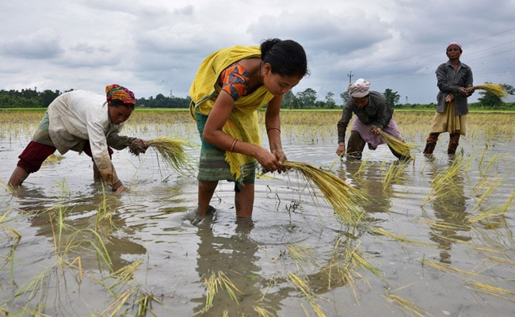
Monsoon flooding
The summer monsoon often brings very heavy rain.
This may also coincide with snow melting and raising river levels
In Bangladesh there are regularly devastating floods in the Ganges delta
The resultant silt deposits when the floods recede make the area extremely fertile

Slide 13
Föhn winds

Slide 14
Föhn winds

Slide 15
Föhn cooling rates
Adiabatic lapse rate = rate at which air temperature changes
Initially moisture in the air is less dense and air cools at dry adiabatic lapse rate (DALR)
When it reaches dewpoint the moisture condenses to form clouds and rain.
It releases latent heat and cools at the slower saturated adiabatic lapse rate (SALR)
Descending dry air warms more quickly at DALR thus raising temperature at the surface on the leeward side

Slide 16
Check your knowledge (2)
The Chinook is a warm dry wind that blows east (inland side) of the Rocky mountains. It is an example of what type of local wind?
How does the monsoon system affect the weather in India?
What is the adiabatic lapse rate?
Name two types of natural disasters that could be associated with Föhn winds.
Parts of South Carolina enjoy cool dry winters, rapidly warming springs and heavy summer rains often flooding farmlands making the area ideal for growing rice. What sort of local winds produce these conditions?

Slide 17
Effects of föhn winds
Milder, drier continental winters
Snow melts and avalanches or floods
Droughts and scorching of crops
Forest or veld fires

