Slide 1
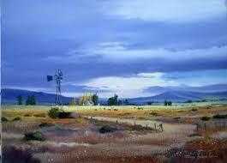
CLIMATE AND WEATHER 3 – sub-TROPICAL anti-cyclones Unit 1 – High pressure systems
Geography grade 12
© j. rich 2020

Slide 2
REVIEW – WHAT HAVE YOU ALREADY LEARNED?
1 minute
Cyclonic systems result from intense low pressure causing warm air to rise and diverge and cool air to converge at the surface.
The movement of air spirals because of the Coriolis effect
Mid-latitude cyclones are associated with the convergence of fronts
Cyclones are temporary and dissipate

Slide 3
Overview – what you will learn
After you have finished this unit you should be able to:
Distinguish how anti-cyclones differ from cyclones
Explain how anti-cyclone systems work
Identify where they operate in South Africa
Explain what the temperature inversion is and how it works

Slide 4
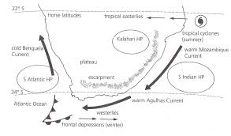
Where are the high pressure systems located
Three fairly permanent systems
The positions shift slightly from time to time
Winds around the HP cells are anticlockwise
At the coast the winds will be onshore
The Kalahari cell causes offshore winds

Slide 5
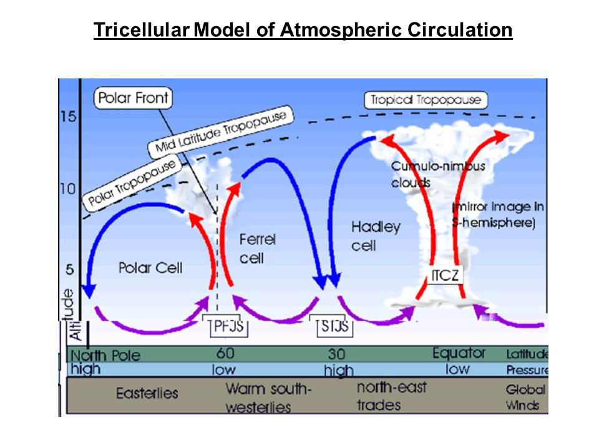
Global air circulation and pressure cells
Equator is a low pressure belt and warm air rises there and diverges towards the poles
As the air moves it cools and becomes more dense so it subsides around 30 deg N or S causing increase in air pressure.
As the air subsides it warms up closer to the surface and its relative humidity decreases.
The warm air diverges along the surface

Slide 6
THE SOUTH ATLANTIC ANTI-CYCLONE
The onshore winds cross a cold current so there is not much evaporation ad the temperature is kept low.
The High pressure cell is close to shore so there is little opportunity to pick up moisture
The west coast is exposed to cool dry winds

Slide 7
THE SOUTH indian ANTI-CYCLONE
The onshore winds cross a warm current so there is high evaporation and the temperature is raised.
The high pressure cell is further from shore so there is more opportunity to pick up moisture
The east coast is exposed to warm moist winds

Slide 8
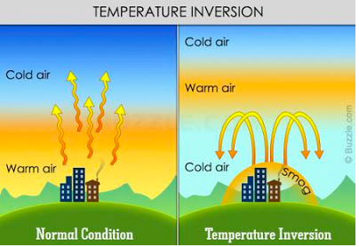
Temperature inversion
Usually the higher one goes the colder the air becomes
In high pressure cells after a certain height the temperature starts to rise again because air warmed during the day is stuck above air cooled at night
If the cooler air is more humid a dense layer of cloud becomes trapped under the lid of warm air

Slide 9
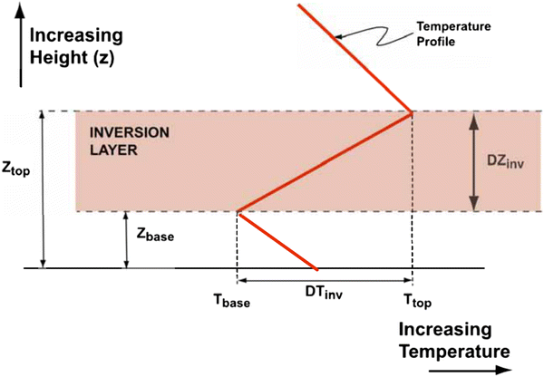
Temperature inversion
The area where the warm air collects is called the inversion layer

