Slide 1
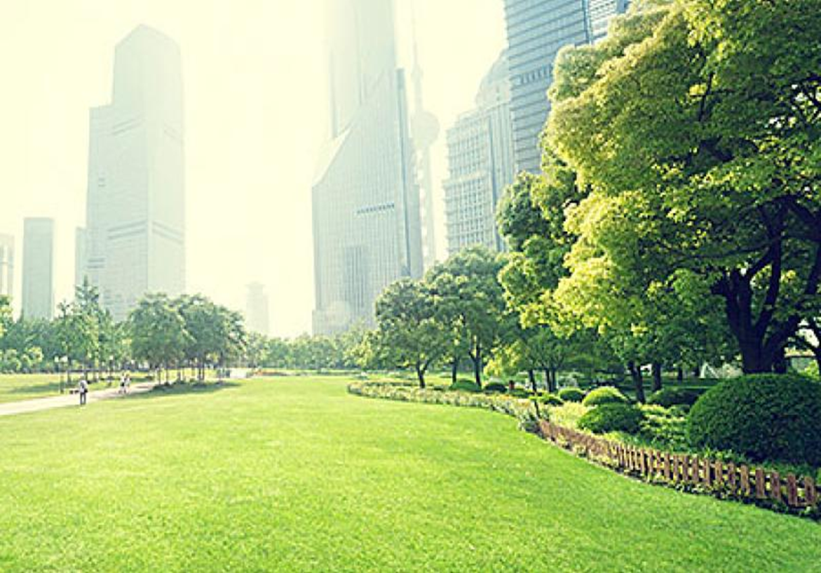
CLIMATE AND WEATHER 5 – URBAN CLIMATES Unit 1 – The micro-climate of cities
Geography grade 12
© J. rich 2021

Slide 2
REVIEW – WHAT HAVE YOU ALREADY LEARNED?
1 minute
Incoming solar radiation can be absorbed, reflected or dispersed depending on the surfaces.
Temperature inversions can trap pollution
Pollution in the air can cause acid rain.
In the southern hemisphere north facing surfaces heat up more than south facing surfaces

Slide 3
Overview – what you will learn
1 minute
After you have finished this unit you should be able to:
Explain and identify six important differences between urban and rural climates
Explain the term heat islands and discuss how these form
Explain the term pollution domes and discuss how these form
Discuss strategies for managing the negative aspects of urban climates

Slide 4
Key climate issues in cities
1 minute
Lower vegetation
Heat islands
Pollution domes

Slide 5
DIFFERENCES BETWEEN URBAN AND RURAL CLIMATE
3 minutes
ELEMENT | IN CITIES | REASON
Temperature | Cities are warmer | Less vegetation and water; artificial surfaces like concrete, tar, brick and wood absorb and lose heat rapidly causing hotter nights Increased pollution levels cause higher absorption of radiation and increased heat
Wind speed | Lower wind speeds except in channels between buildings | Buildings generate friction and act as windbreaks, but tall buildings can channel wind along streets between them forming wind tunnels
Humidity | Humidity is lower, air is drier | Fewer plants so less water vapour through transpiration. Less absorption of groundwater because of runoff into stormwater drains, so less evaporation Warmer air can hold more moisture so higher temperatures cause lower relative humidity
Clouds and precipitation | More cloud cover, fog, smog and precipitation | Cities produce more dust and particles in air that act as condensation nuclei leading to cloud formation. Higher temperatures cause convection – warm air rises cools, condenses and increases chance of rain.
Sunshine | Less sunshine | More cloud cover so greater absorption and reflection of radiation. High rise buildings block incoming radiation and cast shadows. More dust reflects and absorbs sunlight reducing the amount at the surface.
Air pressure | Lower | Higher temperature leads to lower air pressure.

Slide 6
URBAN HEAT ISLANDS
Temperatures are usually 1-4 deg C higher over the city than the surrounding rual areas and may be as high as 10 deg more.
The zone of hot air over the city which is most marked at night is called a heat island

Slide 7
CAUSES OF URBAN HEAT ISLANDS
Heat islands are caused by differences in:
Surfaces
Amount of heat emission
Air quality
Amounts of evaporation and evapotranspiration
B

Slide 8
CAUSE 1: SURFACE DIFFERENCES
Many artificial surfaces like tarred roads are dark so absorb and don’t reflect radiation
More surfaces e.g. large buildings to absorb energy
Greater absorption = greater day time temperature and greater night time re-radiation

Slide 9
CAUSE 2 : AMOUNT OF HEAT EMISSION
More heat added to atmosphere by e.g. factories, vehicle exhaust heat, air conditioning

Slide 10
CAUSE 3: AIR QUALITY
Greater pollution = greater heat absorption ability = raised temperatures
The 50 most polluted cities in the world
Country | No of cities | %
India | 35 | 70
China | 7 | 14
Pakistan | 5 | 10
Bangladesh | 2 | 4
Indonesia | 1 | 2

Slide 11
CAUSE 4: EVAPORATION AND EVAPOTRANSPIRATION
Evaporation from water surfaces and evapotranspiration from plant leaves uses heat and causes cooling
Less of these processes in cities because of less surface water due to runoff over hard surfaces into stormwater system
Less vegetation cover

Slide 12
EFFECTS OF HEAT ISLANDS
POSITIVE EFFECTS
NEGATIVE EFFECTS
Less energy used for heating
Snowfall and frost reduced
Rainfall is increased
Airconditioning use increased using up energy
Heatwaves

Slide 13
POLLUTION DOMES
Cooler air – note condensation
Thermal inversion layer
Pollution dome – air trapped under inversion layer

Slide 14
CAUSES OF POLLUTION DOMES
Temperatures are highest in the city centre
A convection cell is set up over the city.
Cooler air from the edge of the city moves in to the centre low pressure caused by the rising hot air
This circulation spreads the pollution through the dome
Pollution is densest and closest to the ground at night.
By day the air warms and the top of the dome rises higher dispersing the pollution to some extent.

Slide 15
POLLUTION PLUMES
When there is little or no wind the pollution remains trapped in the dome
When there is a stronger wind, the polluted air is blown out of the dome in a down wind direction in the form of a pollution plume
This can carry pollution into neighbouring rural areas

Slide 16
EFFECTS OF POLLUTION DOMES
Increases risk of respiratory problems
Dirties windows and building surfaces
Acid rain

Slide 17
HOW TO REDUCE HEAT ISLAND EFFECT
Change urban surfaces
Use light colours for roofs
Concrete instead of tar roads
Permeable surfaces such as gravel, cobbles and grass
Maintain and develop wetlands
Greening the city
Trees, parks, roof gardens
Reducing pollution
Insulation, solar and “clean” energy, pedestrian and cycle zones
Reducing urban density
Industrial decentralization, lower density housing and height limits

