Slide 1
CLIMATE AND WEATHER 1 – Mid-latitude cyclones Unit 1- Characteristics and location
Geography grade 12
© j. rich 2020

Slide 2
approach
View the slides on the blog
This shows roughly how much time the section should take you
Th
HOW THIS COURSE WORKS
This is how we will work through and master the work in this course
Meet with teacher for discussion
Clicking on these will open a comment or further note
This is the number of the learning or assessment task in the blog
Do the learning & assessment tasks
5%
This unit is about 5% of the term work
Review feedback
INSERT LOGO HERE

Slide 3
Quality standards and expectations
1 minute
At least one face-to-face meeting with your teacher per week.
Prepare for such meetings (your own questions and inputs about the work done)
Complete work on deadline
Edit and check spelling on all work
All work to be neatly hand-written or typed and submitted in hardcopy or electronically
Any copying or cutting and pasting must be acknowledged.
At least 51% of any work must be your own original input

Slide 4
Overview – what you will learn
1 minute
What the general characteristics of mid-latitude cyclones are
How mid-latitude cyclones are different from other cyclones
Where the areas are where mid-latitude cyclones form
How this influences South African weather patterns
What conditions are necessary for mid-latitude cyclones to form

Slide 5
General characteristics of all cyclones
10 minutes
OUTCOME: After completing these slides you will be able to explain 3 important characteristics of all cyclones
Compare the following images of cyclones and list what you notice they have in common

Slide 8
What do you notice about the shapes of the cloud masses / satellite images / synoptic chart images?
What seems to be in the middle of the storms?
What do you notice about the colours (representing pressure levels) or the lines on the synoptic charts?

Slide 9
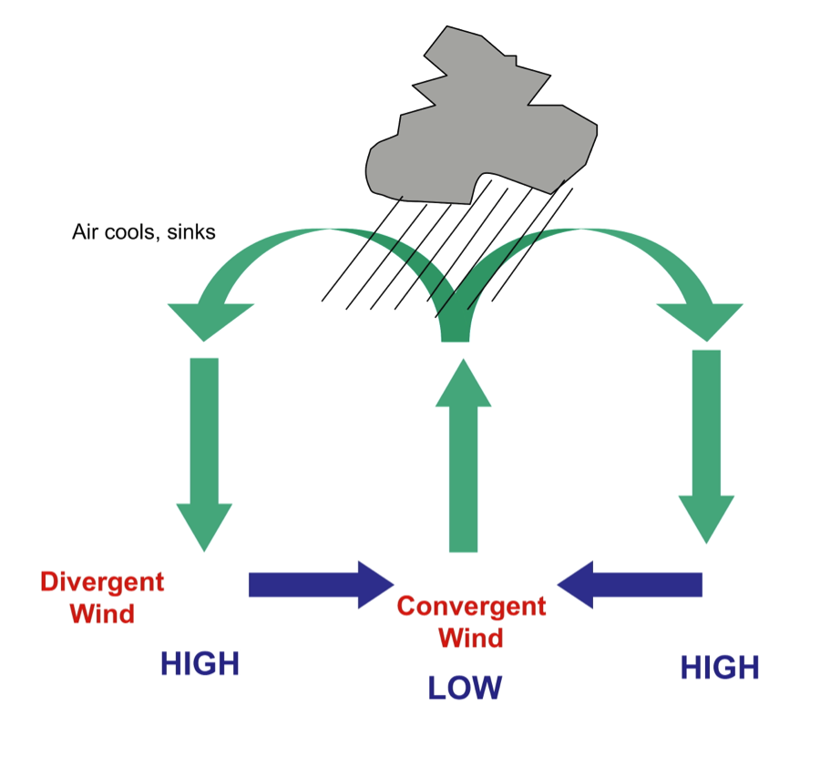
General characteristics of all cyclones
2 minutes
Isobars are closed around a low-pressure centre
As winds move from high to low pressure they are deflected by the Coriolis force to left (clockwise) in Southern hemisphere and right in Northern hemisphere (anti-clockwise)
Air converges at the centre and rises then diverges as it cools in upper air

Slide 10
The distinctive characteristics of mid-latitude cyclones
2 minutes
How do they happen? | Cold polar and warm sub-tropical air masses meet and form warm and cold fronts (only in mid latitude cyclones)
How much (pressure) ? | About 996 hPa at centre
How big? | Diameter of about 1500 – 3000 km
How fast? | Travel at about 50-60 km/h (around 1200 km / day)
How many? | Occur in families of several in quick succession
How long do they last? | Between 4 and 14 days

Slide 11
Areas where mid-latitude cyclones form
10 minutes
Occur between latitudes 30º and 60º Where warm temperate air meets cold polar air

Slide 12
Some questions about location
1.Will the eastern or western sides of continents be more likely to be affected by mid-latitude cyclones? Explain why
2. Does South Africa lie within the latitudes where mid-latitude cyclones form?
3. Which province in South Africa is most likely to be affected by the northward movement of mid-latitude cyclones in winter?

Slide 13
Seasonal implications
How does location of mid-latitude cyclones vary from winter to summer and why?
In Southern Hemisphere during winter the sun is focused over the northern hemisphere so pressure belts and global circulation winds move further north
How does the rain associated with them affect the climate of the south western Cape?
The south western Cape experiences higher rainfall in winter
What effect do the cold fronts of mid-latitude cyclones have on the weather?
There are cold snaps in the interior of the country during winter

Slide 14
Some questions
10 minutes
1. Name three ways in which mid-latitude cyclones are similar to other types of cyclones.
2. Name one characteristic of mid-latitude cyclones that do not occur I other cyclones.
3. How do mid-latitude cyclones in the northern hemisphere differ from those in the southern hemisphere?
4. Why is upper air divergence important in the formation of a cyclone?

