Slide 1
NATIONALISM IN SOUTH AFRICA (1) The Origins of African Nationalism
HISTORY GRADE 11
© J. RICH 2020

Slide 2
OVERVIEW – What this module is about
Unit 1 - Formation of the first African nationalist organizations
Unit 2 – The influence of World War II and the Atlantic Charter
Unit 3 - Different types of African nationalism
African Peoples Organization
The Land Act
SA National Natives Congress
The African National Congress
Atlantic Charter
AB Xuma’s African claims
Returning soldiers
Africanism
Pan Africanism
Nation building

Slide 3
BEGINNINGS – African People’s Organization
Initially a Cape Coloured cultural organization that took up political causes
Drew in Black Africans
W.B. Rubusana edited a Xhosa newspaper Ilizwi laBantu that raised political issues
In 1909 when politicians were discussing the formation of a Union of South Africa blacks were sidelined
Sol T Plaatje and others travelled to Britain to lodge their concerns
The new constitution disenfranchised blacks

Slide 4
South African Natives National Congress

Slide 5
QUESTIONS
1. Why did the group of Africans travel to England?
2. This report was published in the English language newspaper of Kimberley which was read largely by white people. Why was it published there and what effect would it have had?
3. The report was written by Sol Plaatje, a Tswana writer. What does it tell us about the capabilities of the people who were leading the SANNC?
4. Why is a source like this of particular value to historians?

Slide 6
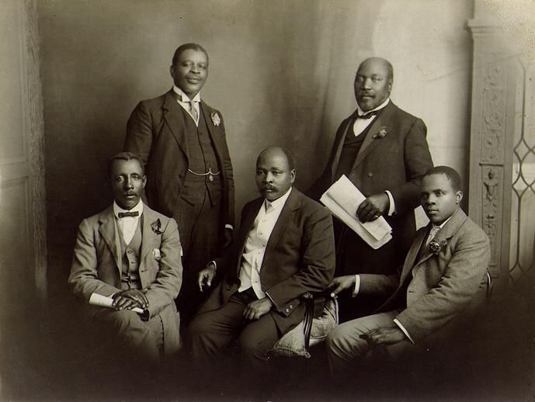
South African Natives National Congress
Concerned about the South Africa Act and (later) the Land Act that removed the vote and land rights from Africans.

Slide 7
AFRICAN NATIONAL CONGRESS In 1912 SANNC became the ANC

Slide 8
ISSUES AND AIMS
Full political rights (vote) for Black Africans
Repeal of the 1913 Land Act
A free (non-racial) South Africa

