Slide 1
POPULATION STUDIES 3 – POPULATION GROWTH
GEOGRAPHY GRADE 10
© j.D. RICH 2020

Slide 2
WHAT ARE THE BIG ISSUES IN THIS UNIT?
POPULATION GROWTH – How has population grown over time?
THE DEMOGRAPHIC TRANSITION MODEL – A way to explain what happens when population grows
OVERPOPULATION – What it means and is it real?
MANAGING POPULATION – Why if and how this could be done

Slide 3
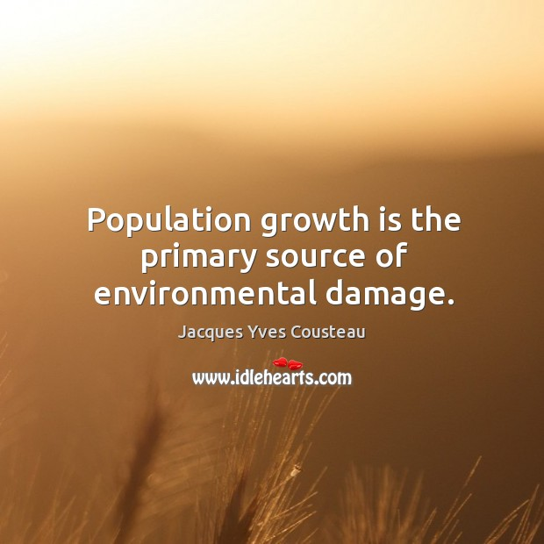

Slide 4
HOW HAS POPULATION GROWN OVER TIME?

Slide 5
SOME QUESTIONS TO CONSIDER
1. Why did the world’s population grow so slowly between 1000 BCE and 1500 CE?
2. What happened between 1450 and 1650 CE to cause a slight dip in world population?
3. When did the world’s population start to grow rapidly and what happened then to produce this growth?
4. What is meant by exponential growth? What are the implications of it? (See the quote on the following slide)
5. Is it possible to know exactly what the population of a country is? Why or why not?

Slide 6
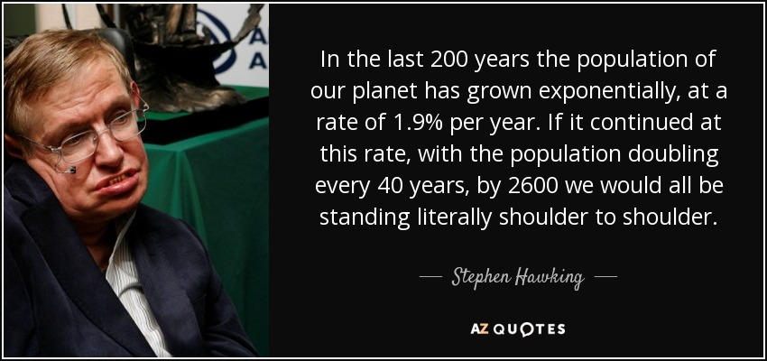

Slide 7
FACTORS AFFECTING POPULATION GROWTH
Population growth differs from country to country (Remember Spain and Kenya?)
It can differ within a country from region to region (Where do you think South Africa’s population is growing fastest and slowest? Why?)
It changes from year to year (How do you think it may differ between 2019 and 2020? Why?)
The population of South Africa actually declined slightly in the period 1916 – 1921, Why?
Can you name three things that have boosted world population growth since 1950?

Slide 8
DEMOGRAPHIC TRANSITION MODEL
A model is:
A simplified representation of an aspect of reality
A tool to help us understand and predict how a part of reality will probably behave

Slide 9
DEMOGRAPHIC TRANSITION MODEL

Slide 10
APPLYING THE MODEL
1, At what stage would you say Kenya is and why?
2. What stage describes the population of Spain? Why do you say that?
3. What is likely to happen in the near future to South Africa’s birth rate? And our population?
4. In terms of South Africa’s planning for 2030 should the focus be on building more primary schools and training foundation phase teachers or increasing the capacity of Universities and colleges? Explain
5. South Africa currently has a huge shortage of housing. Will this still be a problem in 2050 or will we be able to catch up? Explain your thoughts.

Slide 11
OVERPOPULATION – Some key questions
What is overpopulation?
Are there too many people on Earth?
How many people can the earth support?
If God told man to “be fruitful, multiply and fill the earth” did man overdo it?
Are there any things that will limit human population growth?

Slide 12
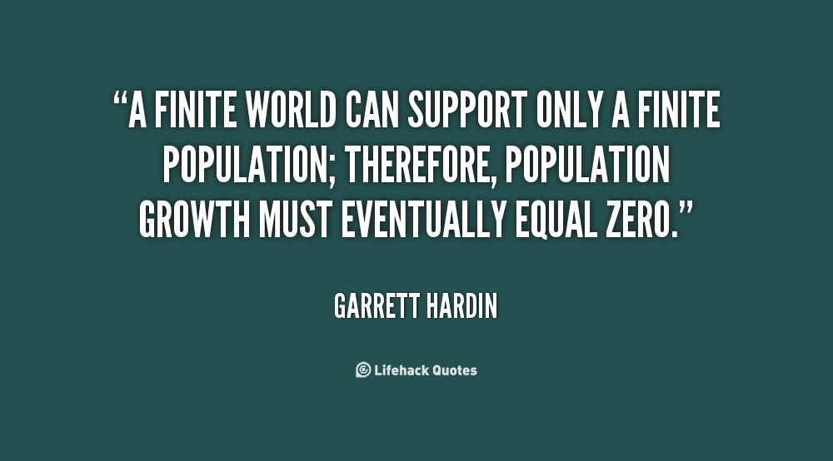

Slide 13
OVERPOPULATION AND RESOURCES
CARRYING CAPACITY – How many people can an area actually support?
SUSTAINABLE GROWTH – Wise/ careful use of available resources to keep a population going
MALTHUS THEORY OF POPULATION (1798)
Quantity of available resources eventually limits population
Populations usually increase as resources increase unless there are powerful controls to stop this
Populations are kept in check through private , voluntary factors or destructive factors
MALTHUS’ THEORY HAS NOT REALLY WORKED IN MOST SOCIETIES!

Slide 14
ISSUES RELATED TO INCREASING POPULATION
WATER – Levels have dropped world-wide while demand has increased
CROPLAND – Less space = more sophisticated /expensive ways to increase yield
DEFORESTATION
FOOD
URBANIZATION
DESERTIFICATION

Slide 15
MANAGING POPULATION GROWTH
SLOWING DOWN GROWTH
Legalising and facilitating family planning contraception and abortion
Taxing larger families
Compulsory family limits (China one child)
Improving living conditions
Encouraging women to get educated and be employed
PROMOTING GROWTH
Family leave benefits
Tax incentives for larger families
Limiting available contraception and abortion
Improving job opportunities and incomes

Slide 16
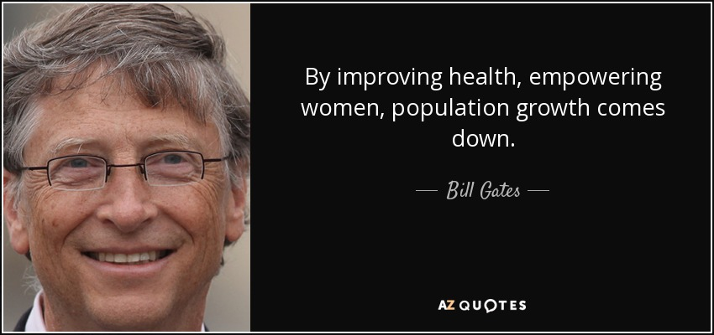
Can you explain this?

