Slide 1
CAUSES OF THE GREAT WAR
HISTORY GRADE 8
© j. d. Rich 2020

Slide 2
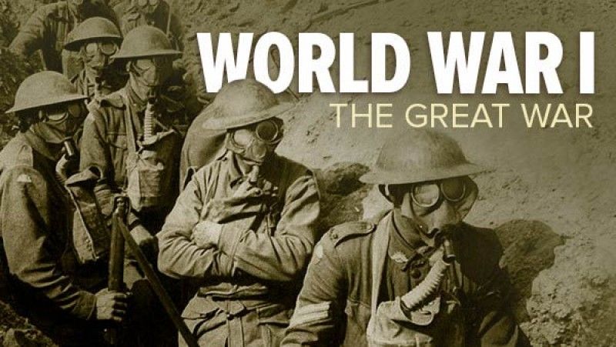

Slide 3
WELCOME AND FINDING YOUR WAY
Welcome to this blended learning unit which is part of the history module on World War 1.
[If you see a speech bubble like this you can click on it and it will open an interesting comment alongside that shares more information,]
This unit consists of four components:
(a) This online self-study unit (blog) which allows you to post your comments and ideas online.
(b) A worksheet assignment that you must complete in class
(c) Class meetings where we will discuss some aspects of the work and you will be able to ask your teacher questions. These meetings will also include some oral assignments to guide discussions
(d) A written test at the end of the module that will be completed in class under controlled conditions.

Slide 4
WHAT WAS THE GREAT WAR?
World War 1 (called the Great War until World War 2 ended) was a fierce armed conflict between many of the world’s strongest nations who joined together in alliances.
Because the empires had colonies, fighting happened in different parts of the world.
It began in 1914 and continued for 5 years until November 1918.
It may seem a long time ago (over 100 years), but the last few veterans only died recently. My father-in-law was a schoolboy then and my grandfather fought in East Africa,
For this reason there are many documents, records, and artifacts available for historians to gain information about the great war.

Slide 5
What was the war like?
Source:https://danversreads.files.wordpress.com/2014/07/somme.jpg

Slide 6
WHY WE STUDY WORLD WAR 1
The map of the world was changed by it.
Centres of power in the world shifted.
Technological developments we take for granted first appeared then
The role of women in society was greatly influenced.
Colonies started to strive for freedom.
The first international peace organization was formed.
Literature, art, music and philosophy were profoundly influenced.
The roots of World War 2 were laid.
Lessons about international diplomacy and politics can be learned

Slide 7
OUTCOMES: What you will learn in this unit.
After completing this unit, you will be able to:
List five main causes of the Great War
Identify the various treaties and parties involved, and show how this would easily result in conflict.
Explain the concept “balance of power” and use a map of Europe to show where different power centres were.
Explain the concepts of Imperialism and nationalism and describe examples of these forces at work in Europe.
Explain the concept of militarism and use tables and charts to show the effects of an “arms race”.
Show how countries exploited internal conflicts to create instability and identify two examples.
Describe how countries use war to gain power over a situation and how they create pretexts or excuses for war.
Explain how the Sarajevo incident triggered the war and use a timeline to communicate this.

Slide 8
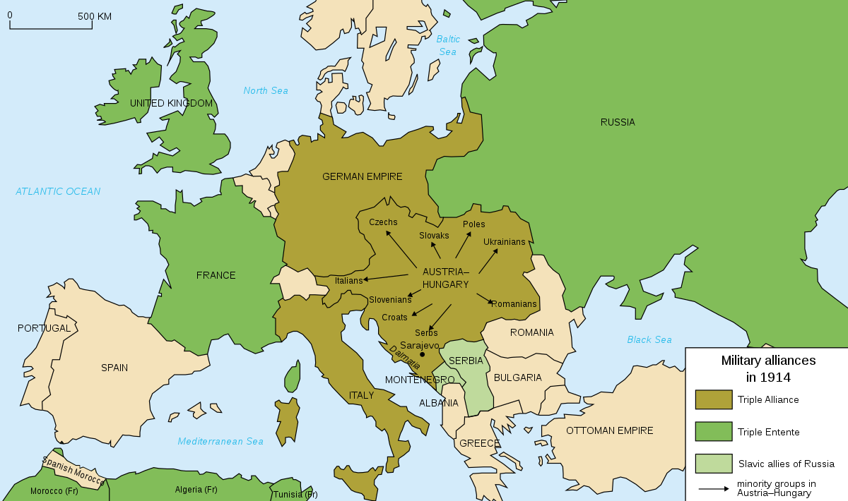
Europe 1900-1913 Source:https://upload.wikimedia.org/wikipedia/commons/thumb/2/26/Map_Europe_alliances_1914-en.svg/1200px-Map_Europe_alliances_1914-en.svg.png

Slide 9
BALANCE OF POWER
Large empires competing for control and wealth and had formed alliances to protect and strengthen their position
Strong nations outside of Europe (USA, China and Japan) preferred to stay neutral and not get involved
Power seen by:
Who controlled the seas
Who had the most colonies
Who had the strongest military power

Slide 10
OTTOMAN EMPIRE
Had become too big and unmanageable
Government was old fashioned and inefficient
Rulers had lost touch with the people
Corruption was widespread
Controlled Dardanelles between Black Sea and Mediterranean – Russia and A-H wanted this.
Was called the “sick man of Europe”

Slide 11
RUSSIA
Weakened by Japanese defeat in 1905
Tsar Nicolas II was a weak ruler who tried to control everything.
Internal discord – new middle class was stirring up peasants
Wanted control of Dardanelles
Had promised support to other Slavic states especially Serbia

Slide 12
AUSTRIA-HUNGARY
Losing control over its many different national groups
Many Slavic minorities unhappy with Germanic Austrian control
Aging Emperor was losing touch- inefficiency and corruption
Keen to get control of Dardanelles or Serbia for better sea access

Slide 13
GERMANY
One of the newest countries in Europe
A dynamic younger emperor, Kaiser Wilhelm and a crafty Chancellor, Bismarck
Developing rapidly as an industrial nation
Had a dispute with France about the French-German region on their border, Alsace.
Were keen to gain more overseas colonies

Slide 14
ITALY AND FRANCE
ITALY
Not very industrialized, a new nation
Soon had a disagreement with Austria-Hungary about the area of Trieste and Venice and left the triple alliance to support France and Britain
FRANCE
Second largest overseas empire
Not as industrialized as Britain and Germany, but catching up.
In conflict with Germany – old enemies

Slide 15
GREAT BRITAIN
Greatest international empire in world history
Largest and most modern navy in the world
Protected from direct invasion by sea
Most industrialized nation in the world at the time

Slide 16
LONGTERM CAUSES: MILITARISM

Slide 17
LONGTERM CAUSES: ALLIANCES

Slide 18
LONG TERM CAUSES: IMPERIALISM

Slide 19
LONG TERM CAUSES: NATIONALISM
Pride in one’s own country
“Newly established “ nations of Italy and Germany
Competition for importance
Sense of National superiority
Desire for autonomy and freedom by ethnic groups
Trans border national sympathies

Slide 20
LONG TERM CAUSES: INTERNAL UNREST
1st and 2nd Balkan Wars
Panther incident in Morrocco
Herero genocide
1st Russian Revolution of 1905
Irish nationalism

