Slide 1
settlements
Grade 8 geography – mr rich

Slide 2
INTRODUCTION
ikasi yethu, my dorp, my pozzie, our town, loksheni, ilali yam
Everywhere people have made places to stay and work and we call these settlements. One of the very first things God did for mankind was to make a “place”, the garden of Eden, for them. This unit will look more closely at these.
Key questions
What makes people settle where they do?
Are there different kinds of settlements?
How are settlements affected by the way people are using the land?
What problems is the world facing relating to settlements and what solutions are there?

Slide 3
LEARNING OUTCOMES FOR THIS MODULE
At the end of this module you will be able to
Explain what a settlement is
Give six reasons why settlements form
Identify examples of each type of settlement
Explain what push and pull migratory factors are and give examples of each in drawing people to move into cities.
Explain what led to the formation of a large settlement in Johannesburg.
Explain what urbanisation is and how it affects people’s lives.
Extract information from statistics and reflect trends visually using a graph
Discuss six types of land use zones in an urban area.
Locate and describe land use zones on a map of an urban area and explain why they are probably located where they are.
Explain ways in which God makes us move / change where we are or stay where we are physically and spiritually and reasons why He does so.
Apply the theory learned to analyse Gonubie as a settlement.

Slide 4
ACTIVITY 1 – LEARNING FROM A SATELLITE IMAGE
In this activity you will be introduced to satellite imagery and you will use the information from an image to identify patterns of where people and settlements are located on earth.
You will begin to think about possible reasons why people form settlements where they do.
You will begin trying to formulate your own definitions for key terms

Slide 5
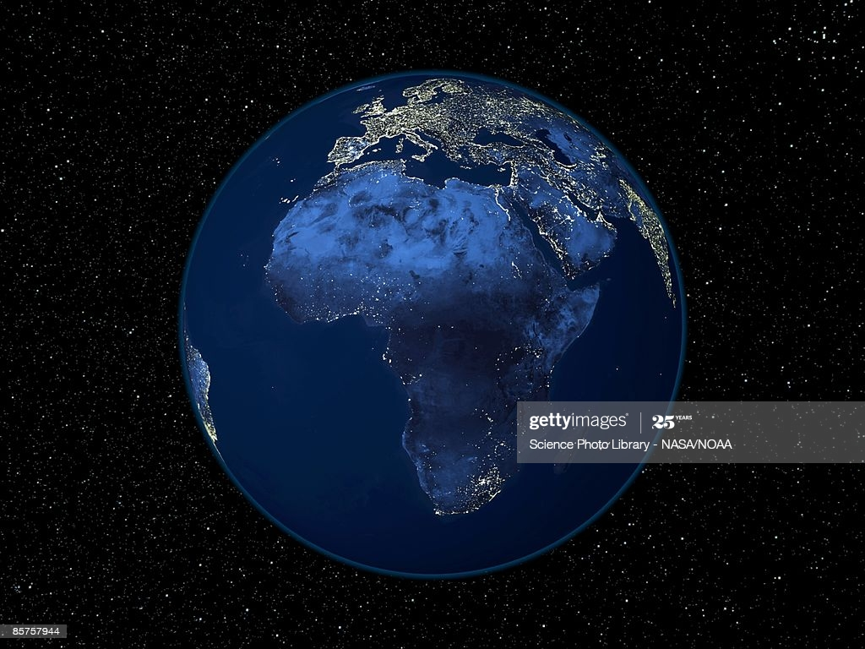
WHERE IN THE WORLD IS EVERYBODY?
Study the satellite image below then answer the questions on the next slide

Slide 6
QUESTIONS ABOUT THE SATELLITE IMAGE
What is a satellite image?
What time of the day is it in the areas shown in the image?
Why are some areas brightly lit up?
What does this suggest about settlement patterns?
Which areas are most lit up in South Africa? Are these mostly urban or rural areas?
Give possible reasons why some areas are completely dark?
Write your own working definition for the term “settlement”

Slide 7
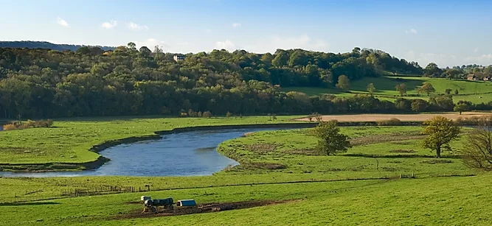
ACTIVITY 2 – REASONS FOR SETTLEMENT
Examine the picture below then make two lists: all the positive reasons why people might choose to build a settlement there , and all the negative reasons against settling there.
Examine the picture below then make two lists: all the positive reasons why people might choose to build a settlement there , and all the negative reasons against settling there.

Slide 8
REASONS FOR FORMATION OF SETTLEMENTS
Settlements are established for many different reasons and as time passes they often develop additional purposes
Administrative- e.g courts or capitals
Commercial – e.g. trade or distribution of goods, market towns
Military – e.g. camps. Forts
Agricultural – the climate or conditions are ideal for certain crops
Transport – e.g. airports, harbours or rail links
Tourism or education – e.g. A university town or a holiday resort
Religious or ceremonial – e.g. a shrine or sacred place or a temple
Industry or mining – e.g. A coal mining area or somewhere like Detroit where cars were manufactured

Slide 9
WHY PEOPLE MOVE FROM ONE SETTLEMENT TO ANOTHER

Slide 10
THE GROWTH OF BUILT UP AREAS IN JOHANNESBURG

Slide 11
POPULATION GROWTH IN JOHANNESBURG OVER A CENTURY

Slide 12
HOW IS LAND USED IN CITIES
An area where land is used for a special purpose is called a land use zone.
Central business district (CBD)
Commercial centres and shopping malls
Industrial zones – light and heavy industries
Services and recreation – libraries, hospitals, schools etc.
Residential – low, middle and high income / density

Slide 13
RURAL SETTLEMENTS
These are smaller settlements linked to producing food or exploiting natural products. They can range in size from single farms or homesteads to small towns.
Main types:
Farming
Fishing
Forestry or nature conservation
Mining

Slide 14
SOME QUESTIONS TO THINK ABOUT
Why are people moving away from rural areas to cities?
Why could this become a problem for rural areas?
What can be done to attract people to settle in rural areas?
What problems could it pose for cities?
Why is it important to avoid the development of informal settlements?

