Slide 1
Fluvial Processes River Capture
GRADE 12 GEOGRAPHY – MR RICH

Slide 2
LEARNING OVERVIEW
In this lesson you will learn about two forms of river capture, what causes them, and how they present.
Key terminology you will need to master from this unit is:
river capture stream piracy
abstraction headward erosion
headwaters elbow of capture
wind gap knickpoint
captor stream captured stream
misfit stream

Slide 3
HEADWARD EROSION

Slide 4
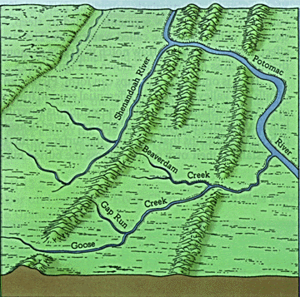
ABSTRACTION
When there are streams on opposite sides of a watershed and one of the streams is more overgraded than the other, it will erode backward (headward) and capture the less graded stream.
In the example below Beaverdam Creek is tending towards capturing the Shenandoah River

Slide 5
ABSTRACTION

Slide 6
STREAM PIRACY

Slide 7
POSSIBLE CAUSES OF STREAM PIRACY
1. Greater volume in the capturing stream due to increased rainfall or climate change
2. Unequal rock resistance – one side of the watershed has harder rock than the other and the river where the rock is softer will erode more quickly
3. Human intervention e.g. dams
4. Geological activity such as earthquakes can alter river flow or volume

