Slide 1
CLIMATE REGIONS Module 1 - Factors that affect temperature and rainfall
GR 8 GEOGRAPHY– MR RICH – 12 MAY 2020

Slide 2
HOW TO FIND YOUR WAY AROUND THIS MODULE
3 MINUTES
When you have completed this page you will understand how to find things and how to work through the module.
You do not have a text book or a teacher in front of you in the classroom so learning has to be done in a slightly different way.
You will find a number of slides or pages like this one. Each page is about one main idea. The heading of the page will tell you what it is about.
Under the heading is a sentence in red that will tell you what you will find out or learn on the page. When you have worked through the page click on the DOWN arrow on your keyboard to move to the next page or the UP arrow to go to the previous page. (Try it now! Go back to the previous page, the title and then come back to this page.)
Some pages will refer you to other sites such as the Wiki using a link like this: http://www.lifebridgeschool.co.za/wiki/index.php?title=Geomorphology_-_Rivers
or other sites on the internet with a link like this: https://www.tulane.edu/~sanelson/eens1110/streams.htm
Place your cursor over the link and left-click to open the page.
In the top right hand corner is a with an estimate of how long it should take you to complete the page. This just an estimate and it may take you la little longer or shorter, but it gives you some idea of the pace you should be working.
You don’t have to finish the whole module all at once, but you should try to do some work every day.
yellow box

Slide 3
FINDING YOUR WAY – SOME MORE TIPS
3 MINUTES
When you have finished this page you will know how to open information boxes, how to do activities and how to use the comments box at the end of the blog page.
Sometimes a new or important word or concept will have an information box like this. By left –clicking on the box, you will open a comment to the right which will explain the word or concept in more detail or give you more information. (Try it now – click on the box!)
On most pages you will find an ACTIVITY. Each activity will have clear instructions. It is important to do each activity.
On the top left-hand corner is a brown arrow with a number. That is the page number. The next page will tell you on which page you can find a particular topic.
Right at the end of the blog page is a space where it says “Leave a reply” and there is a box below. Put your cursor in that box and start typing your comment. When you are finished click enter. Easy as that! (Try it now – go to the end of the blog page and enter your name and a greeting for the class. Write a sentence telling us what you think of the weather today.)

Slide 4
HOW THIS MODULE IS SET OUT
2 minutes
When you have completed this page you will understand how this module is organized and where to find different topics.
TOPICS | PAGE | TOPICS | PAGE
How to find your way around the module | 2 | LO 2 Effect of latitude on temperature (Activity 7) | 11
Finding your way – some more tips | 3 | LO 3 Effect of distance from the sea (Activity 8) | 12
How the module is set out | 4 | LO 4 Effect of height above sea-level (Activity 9) | 13-14
How to get support and stay in contact (Activity 1) | 5 | LO 5 Effect of ocean currents – (a) Convection | 15
Do your own work with integrity (Activity 2) | 6 | LO 5 Effect of ocean currents – (b)Ocean currents | 16
Quality standards and expectations (Activity 3) | 7 | LO 5 Effect of ocean currents – (c)Mapwork (Activity 10) | 17
Why are we learning about climate and weather? ( Activity 4) | 8 | LO 6 Effect of mountains | 18
Assessment | 9 | Module summary and reflection | 19
LO 1 Distinguish weather and climate and describe components of weather(Activities 5 & 6) | 10

Slide 5
HOW TO GET SUPPORT AND STAY IN CONTACT
5 MINUTES
When you have completed this page you will understand why it is important to keep in contact with your teacher and fellow students and how and when you can and must do so.
It is really quite tough to be working on your own at home instead of at school as you are used to doing. It is difficult to stay motivated and keep focused. It is also tricky if you have a question or don’t understand something. You can easily get discouraged and want to give up. Another problem is that you don’t get the benefit of sharing ideas with other learners and helping each other. How do we get around these obstacles?
1. Ask your teacher! You may contact your teacher at any time but the best times are 0930-1230 and 1430-1600 every day on WhatsApp or call at 0720452674 or on Skype at johanrich1.
2. Compulsory check in You must check in on WhatsApp every Monday morning between 1100 and 1130 with a message, voice note or call to say how you are managing and to ask any questions.
3. Join the conversation Please make as much use as possible of the comment box at the end of the blog to post questions, suggestions, comments and other information and please respond to each others comments. Part of your assessment is a participation mark because you are required to post at least two (2) comments per week.
4. Study buddies. You are encouraged to share ideas and information with each other especially around the tasks and help each other to complete tasks and you may use any way to do so that works for you.
ACTIVITY 1 (a) Post a comment in the comment box at the bottom of the blog stating one question about weather that you would like to find the answer to in this module. (Deadline Friday15 May

Slide 6
DO YOUR OWN WORK WITH INTEGRITY
2 MINUTES
When you have completed this page you will be able to explain why it is important to do your own work and not copy blindly from other sources. You wil also be able to define plagiarism.
Did you know that ideas, words and even pictures are property? That’s right they belong to the person who first made them in the way that your cell phone belongs to you or that you belong to your parents. We call them intellectual property. That means you could steal an idea or a picture in the same way as you could steal a cell phone. When you use somebody else’s work and pretend that it is your own this is dishonest and it is called plagiarism.
If you do use work from the internet or anywhere else you are expected to make a note in brackets saying where you got the work from.
Copying someone else’s work or getting someone else to do your work and then claiming to have done the work your self is dishonest and not acceptable. We are expected to uphold truth and integrity at all times out of respect for each other, for God and for ourselves.

Slide 7
QUALITY STANDARDS AND EXPECTATIONS
5 MINUTES
After completing this page you will be able to explain steps you can take to ensure that your work is of an excellent standard.
Although you are not in the classroom and working online is a different experience to normal school work, you are still expected to aim for excellence and submit the best possible work that you are capable of doing.
Here are some steps you can take to ensure quality work:
Allow yourself enough time to avoid doing rushed work.
Break up your longer assignments into smaller parts and plan when you will do each part.
Use a spelling and grammar checker and a dictionary
Check your completed assignment against the question or task description to ensure that you have met the requirements
Ask a parent, family member, classmate or friend to check your assignment before you submit it.
Always check that you have acknowledged every reference properly.
ACTIVITY 3. In the comments box at the end of the blog share one thing you plan to do to make sure the work you submit is the best you can do. (Deadline Friday 15 May)

Slide 8
WHY ARE WE LEARNING ABOUT CLIMATE AND WEATHER?
8
15 MINUTES
When you complete this page you will be able to state at least three important ways that weather can affect our lives.
You could describe an egg as consisting of four parts, a yolk, a liquid white, a thin membrane, and a shell. In some ways, our planet is like that. There is the sphere under the surface the surface which is mostly water and a thin layer of land and the air above the surface, called the atmosphere.
Each of these layers is very busy and there is something happening in them all of the time, but in many ways the busiest is the atmosphere which changes from hour to hour and place to place. These changes are what we call weather. When you got up this morning did you take a look outside the see “what the weather was like”? Why? What difference does it make? If the state of the weather matters to you it must matter to others as well. Is it hot or cold, wet or dry, windy or still?
ACTIVITY 4 In the comments box at the end of the blog list as many reasons as you can why weather is important to different people e.g. sportsmen need to know if they can play a match or will they be rained out. (Deadline Monday 18 May)

Slide 9
ASSESSMENT
2 MINUTES
After you have finished this page you will know how your learning will be assessed and what will be done with the results of your assessment.
Each activity will be used to check whether you have reached the learning outcome for that particular part of the work. It will show you and your teacher how much you have mastered and what you still need to do to master the rest. Each activity will be rated on a four point scale: 0= Not done or completely off the point; 1= Attempted but incomplete or largely misunderstood, still needs more work; 2= Complete and shows adequate understanding but may need to improve some small aspect; 3 = Completely mastered and shows advanced ability or insight. You will be given feedback on each activity.
The total of all your activity ratings will form part of your term mark for this subject.
You will receive an assessment of participation and engagement based on your completion of the activities and your posting of blog comments. You must post at least 2 blog comments each week (you may post more.
The results of this assessment will be used to determine if you are ready to move onto the next module.

Slide 10
TOPIC 1: WEATHER OR CLIMATE?
18 MINUTES
LEARNING OUTCOME 1 : You will be able to explain the difference between weather and climate
ACTIIVTY 5
1. Watch this video clip https://www.youtube.com/watch?v=YbAWny7FV3w&feature=emb_rel_end
2. Write or type out the following sentence and post your response in the comment box (remember to include your name): Weather is __________________________ and it changes______________, but climate is ________________________ and it changes __________________. (Deadline Monday 18 May)
LEARNING OUTCOME 2: You will be able to identify the three most important components of weather
ACTIVITY 6
Study the following examples of weather reports
(a) https://www.google.com/url?sa=i&url=https%3A%2F%2Fleancrew.com%2Fall-this%2F2008%2F05%2Fbetter-weather-forecasts-for-the-iphone%2F&psig=AOvVaw2rufxhP9tSsbM-BynSAvs_&ust=1589454124859000&source=images&cd=vfe&ved=0CAIQjRxqFwoTCOiniJfYsOkCFQAAAAAdAAAAABAI
(b) https://www.google.com/url?sa=i&url=http%3A%2F%2Fwww.skywatchweather.com%2FServices%2Fnewspapers.html&psig=AOvVaw2rufxhP9tSsbM-BynSAvs_&ust=1589454124859000&source=images&cd=vfe&ved=0CAIQjRxqFwoTCOiniJfYsOkCFQAAAAAdAAAAABAN
2. List three important ingredients of weather that are reported on in both reports. Post your response in the comments box on the blog page with your name. Check each others responses and give feedback. (Deadline Monday 18 May)
5 MINUTES
2 MINUTES
8 MINUTES
3 MINUTES

Slide 11
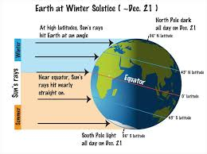
LO 2 SHOW HOW LATITUDE AFFECTS TEMPERATURE
10 MINUTES
When you have finished this page you will be able to use a diagram to show how latitude affects the temperature at different places.
ACTIVITY 7
Look carefully at the diagram on the right .
Remember, the more direct sunlight on a spot
the hotter that spot will be.
So, in general, the further a place is from the
Equator, the higher the average temperature.
Now watch this video clip for another
Perspective: https://www.youtube.com/watch?v=VcPdTZKK1Go
Now check how well you understand this: Take a
sheet of paper and a pen and sit down with a
member of your family and explain to them how latitude affects temperature. Post a comment in the blog to tell us how it went (Deadline Tuesday 19 May)

Slide 12
LO 3 HOW DOES DISTANCE FROM THE SEA AFFECT TEMPERATURE?
25 MINUTES
When you have finished this page you will be able to explain why places that are inland tend to have more extreme temperatures than places at the coast.
ACTIVITY 8
(A) Queenstown gets much hotter and much colder than East London ever does. Read the following article and explain in about four sentences why this is. Post your answer on the blog page with your name and give your classmates feedback on their answers. (Deadline Tuesday 19) Here is the link to the article: https://steemit.com/geography/@donfelix/how-distance-from-sea-affect-weather-and-climate
(1) Which place will have more windy days: Queenstown or East London? Why?
(2) Suggest how your answer to question (1) above will affect the amount of rainy days at each place?
Post your answers at the end of the blog with your name. (Deadline Wednesday 20 May)

Slide 13
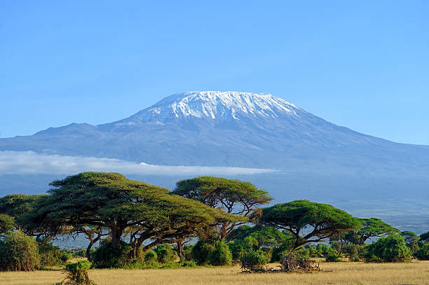
LO 4 HOW HEIGHT ABOVE SEA LEVEL AFFECTS TEMPERATURE
20 MINUTES
When you have completed the following two pages you will be able to explain why the temperature will be lower at places high above sea level compared to places at sea level.
First let’s learn some new terms: altitude = the height above sea level elevation = difference in height from one place to another adiabatic lapse rate = the rate at which the temperature drops as on moves higher temperature inversion = what happens when cold air sinks (usually at night) and gets trapped in a low lying , confined space such as a narrow valley
Now think about this: Hot air rises and the top of a
mountain is closer to the sun so why do we find that
the top of mountains are often much colder than at
the foot of the mountain. For example Mt
Kilimanjaro is almost on the equator but near the
top has snow most of the year around. Why is this?
Perhaps this video will give you a clue:
https://www.youtube.com/watch?v=BxS0fInNF0s

Slide 14
The heat from the sun warms up the surface of the earth and some of the heat is reflected and warms up the air close to the earth’s surface.
When the air molecules are heated they move about quicker and collide into each other more often.
Each time molecules bump into each other energy in the form of heat is released.
The molecules start to move further and further apart which is why the hot air moves upward (rises).
The higher one moves up ward the less air molecules there are (we say the air is “thinner”) so there are fewer molecules to collide and less heat energy is released.
This is why air is cooler the higher one moves. The temperature on average drops by 6.5ºC per 1000m.
ACTIVITY 9
Winterpeaks ski resort is 5800m above sea level and Mountainvale is 2800m above sea level. The temperature at Mountainvale is 21,5 ºC. What is the temperature likely to be at Winterpeaks: (a) 19,5ºC (b) 2ºC (c) 6,5ºC (d) -6,5ºC?
Post your answer with your name at the end of the blog page – deadline Wednesday 20 May.

Slide 15
LO 5 WHAT EFFECT DO OCEAN CURRENTS HAVE ON TEMPERATURE AND RAINFALL – (a) CONVECTION
10 MINUTES
After you have worked through the next few pages you will be able to:
describe what an ocean current is,
explain what effect it has on temperature and rainfall, and
identify some important ocean currents.
By the end of this page you will be able to explain what convection is and how convection currents work.
To understand how ocean currents work we need to understand what convection is and how convection currents work. Convection occurs when there is uneven heating in a body of gas ( like air) or liquid (like water) . This video shows how it happens: https://www.youtube.com/watch?v=Ga1hs2T48Nw.
I am sure you noticed that :
Heat causes air or water to rise
After a while the heated substance starts to cool and moves sideways
Eventually it cools and sinks
At the same time, the space caused when heated air or water rose gets taken up by cool air or water moving in from the side
We call this movement a current.

Slide 16
LO 5 WHAT EFFECT DO OCEAN CURRENTS HAVE ON TEMPERATURE AND RAINFALL – (b) OCEAN CURRENTS
6 MINUTES
Working through this page will help you to be able to describe what an ocean current is.
The following video explains many interesting details about ocean currents:
https://oceanservice.noaa.gov/facts/current.html
Important facts:
Ocean currents are fairly permanent patterns of movement of water in the ocean
There are surface and deep currents
Surface currents carry warm or cold water to other areas and affect the climate
They are driven by tides and winds
Deep currents are mostly affected by heat and the saltiness or density of the water
The warm or cold water causes air pressure to be higher or lower and as a result the winds either blow moist air onto the land or draw it away from the land.
For example the cold current moving up the west coast of South Africa makes the coastline very dry and semi desert and the warm current moving down the east coast brings warm humid conditions, higher rainfall and tropical storms .

Slide 17
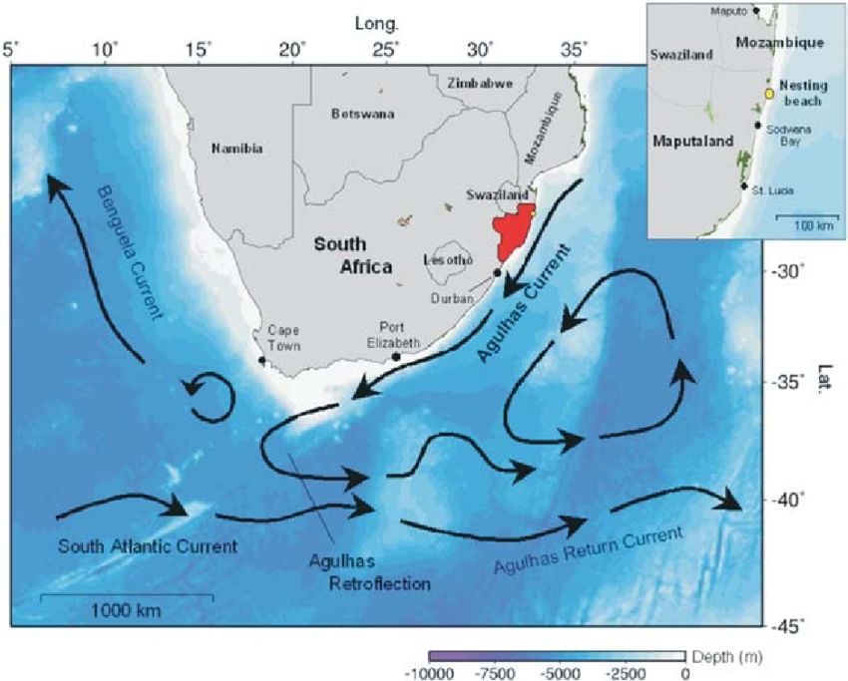
LO 5 WHAT EFFECT DO OCEAN CURRENTS HAVE ON TEMPERATURE AND RAINFALL – (c) MAPPING CURRENTS
14 MINUTES
When you complete this page you will be able to name important ocean currents around South Africa and describe their effect on climate.
ACTIVITY 10
Study the map alongside and answer the
questions below posting your answer at the
Bottom of the blog with your name (Deadline
Thursday 21 May)
1. What sort of water is carried along by the
Agulhas current?
2. Why is Durban a popular holiday
destination in winter?
3. What does that have to do with ocean
currents?

Slide 18
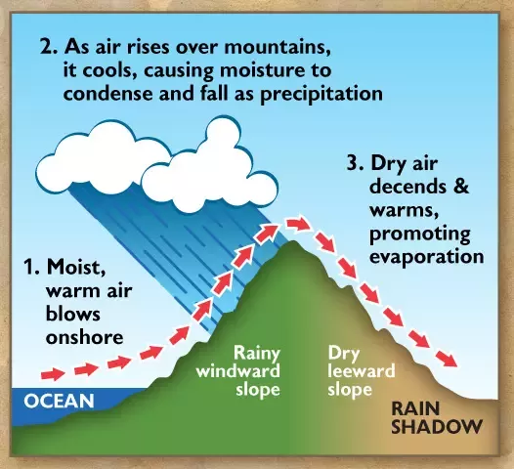
LO 6 HOW DO MOUNTAINS AFFECT TEMPERATURE AND RAINFALL
10 MINUTES
When you have completed the activities on this page you will be able to explain how mountains affect the temperature and rainfall around them. You will be able to explain the meaning of the terms maritime and continental climates, catchment areas and rain shadow areas.
The diagram alongside explains how mountains influence climate
The ocean is warmed by the sun and moist air rises causing high pressure.
Air moves from the high pressure to the low pressure area over the cooler land bringing in moisture.
When the winds meet the rising land of mountain ranges the moist air cools and condenses causing rain to fall on the seaward side of the mountains. This weather is called a maritime climate.
On the other, inland, side of the mountains the air is dry leading to lower rainfall and this is called a continental climate.
The windward side where the rain falls is also called the catchment area and the leeward side is called the rain shadow
.

Slide 19
MODULE SUMMARY AND REFLECTION
20 MINUTES
This page will allow you to reflect on what you have learned from this module and it will give you an opportunity to share feedback on the module.
ACTIVITY 11
Post a comment (with your name) at the end of the blog commenting on the following:
What are three new things you have learned by doing this module?
What did you enjoy or what worked well for you in the module?
What would you suggest be improved in the module?
Was the time allocation suggested too little time, too much or mostly just right?

